Slide 1
[Fjern denne]
Description of the structure
Objective of the work
Description of the loading and the boundary conditions
Description of the model:
material’s model
translation of the loading and boundary conditions in the corresponding FE ones
choice of the element type and size
Results
Discussion of the results (with comparison with simplified, analytical solutions)
Conclusion

Slide 2

TODO list
Add numerical simplyfied solution
Add apple-emoji
Add Abaqus model
Add sources
Add pictures of effects of different mesh sizes
Delete this and previous page

Slide 3

Analysis of displacements for a plate of aluminium with uniform load with different boundry conditions, in Abaqus

Slide 4
Outline
Description
Model
Abaqus Simulation
Discussion & Comparison
Conclusion
Abaqus Model

Slide 5

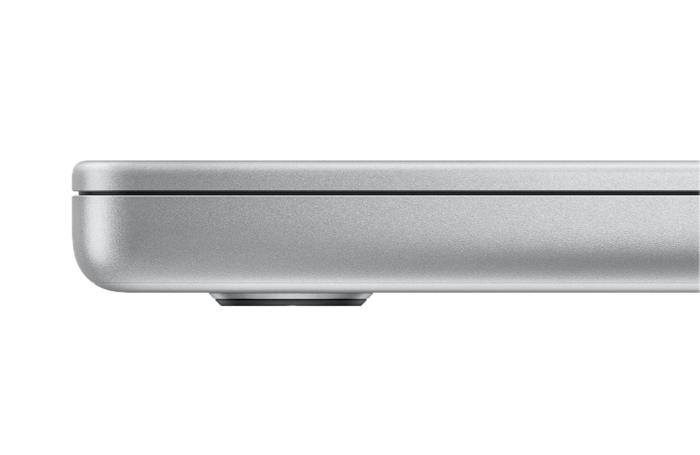
Description
Idea
How much force does it take for a Macbook Pro to bend 1mm?
What is the effect of a uniform load without and with feets?
Assumptions
Thin plate theory
One unified block of aluminium

Slide 6
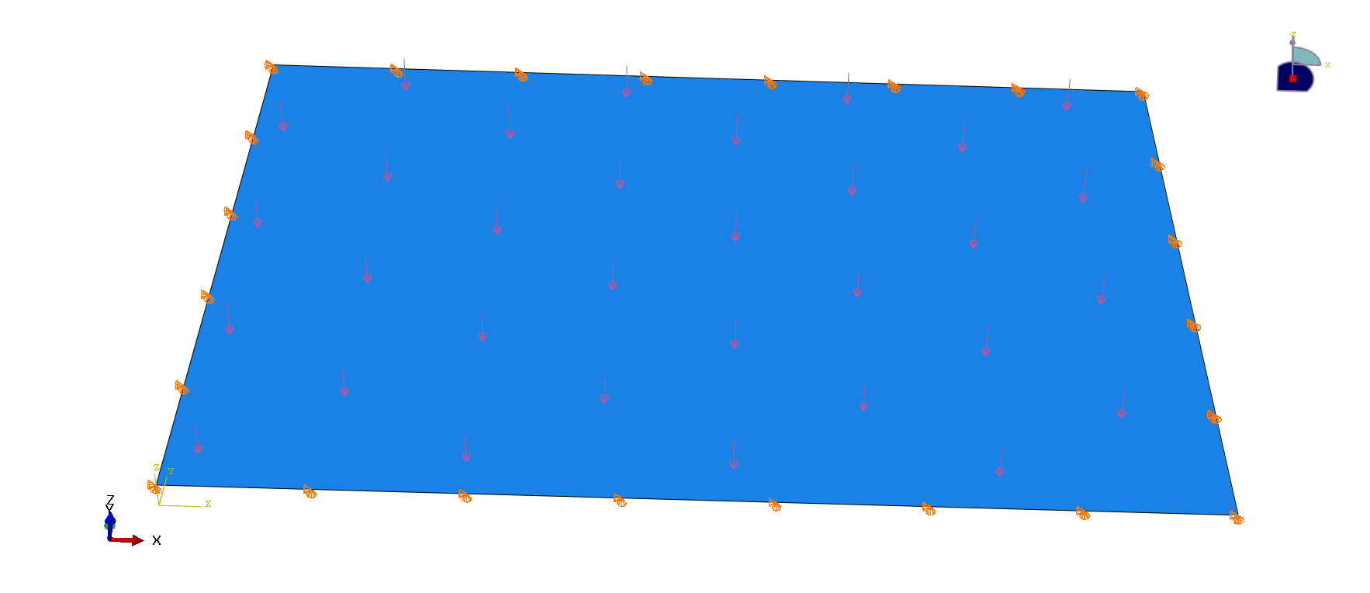
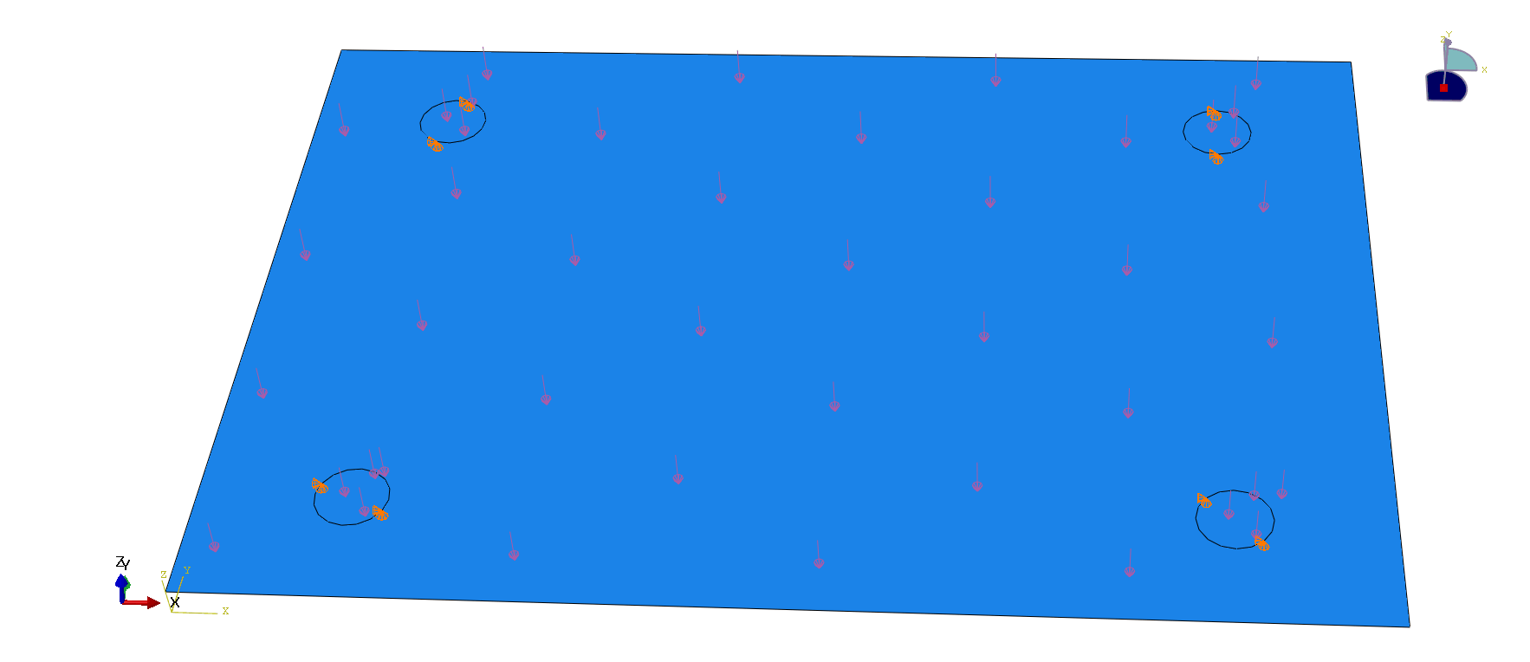
Model
Structure
width = 312.6mm
height = 221.2mm
thickness = 15.5mm
Load
Both cases have uniformed distrubuted load
Material Properties
Alumnium
E = 72GPa
V = 0.333
Boundary Condition
Either edges or feets are simply supported

Slide 7
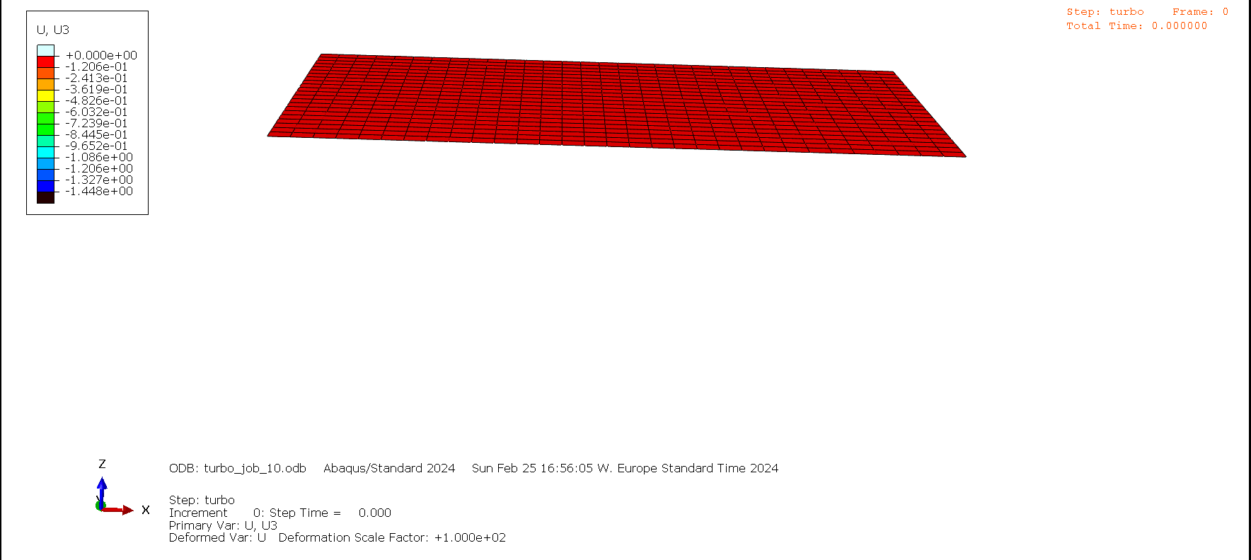
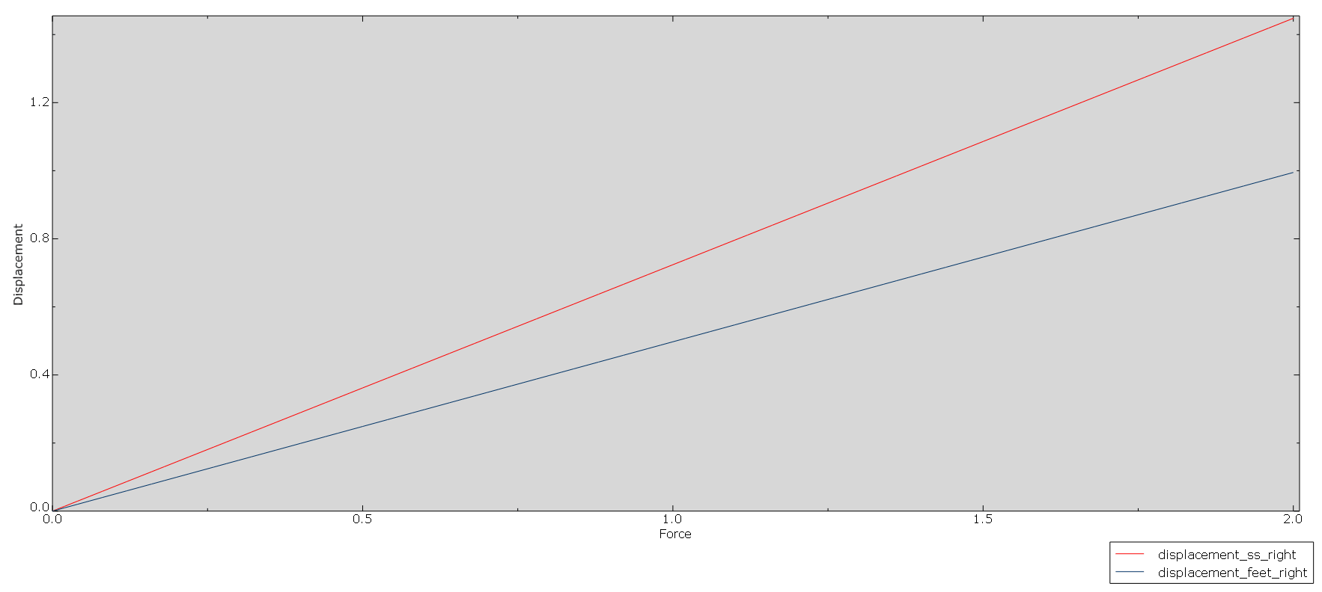
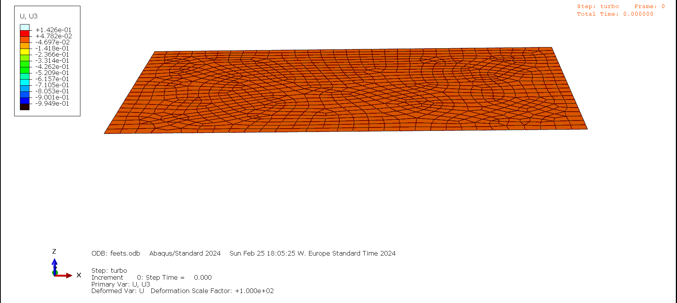
Abaqus Simulations
Comments
Smaller displacements for feet than edge for the same force

Slide 8
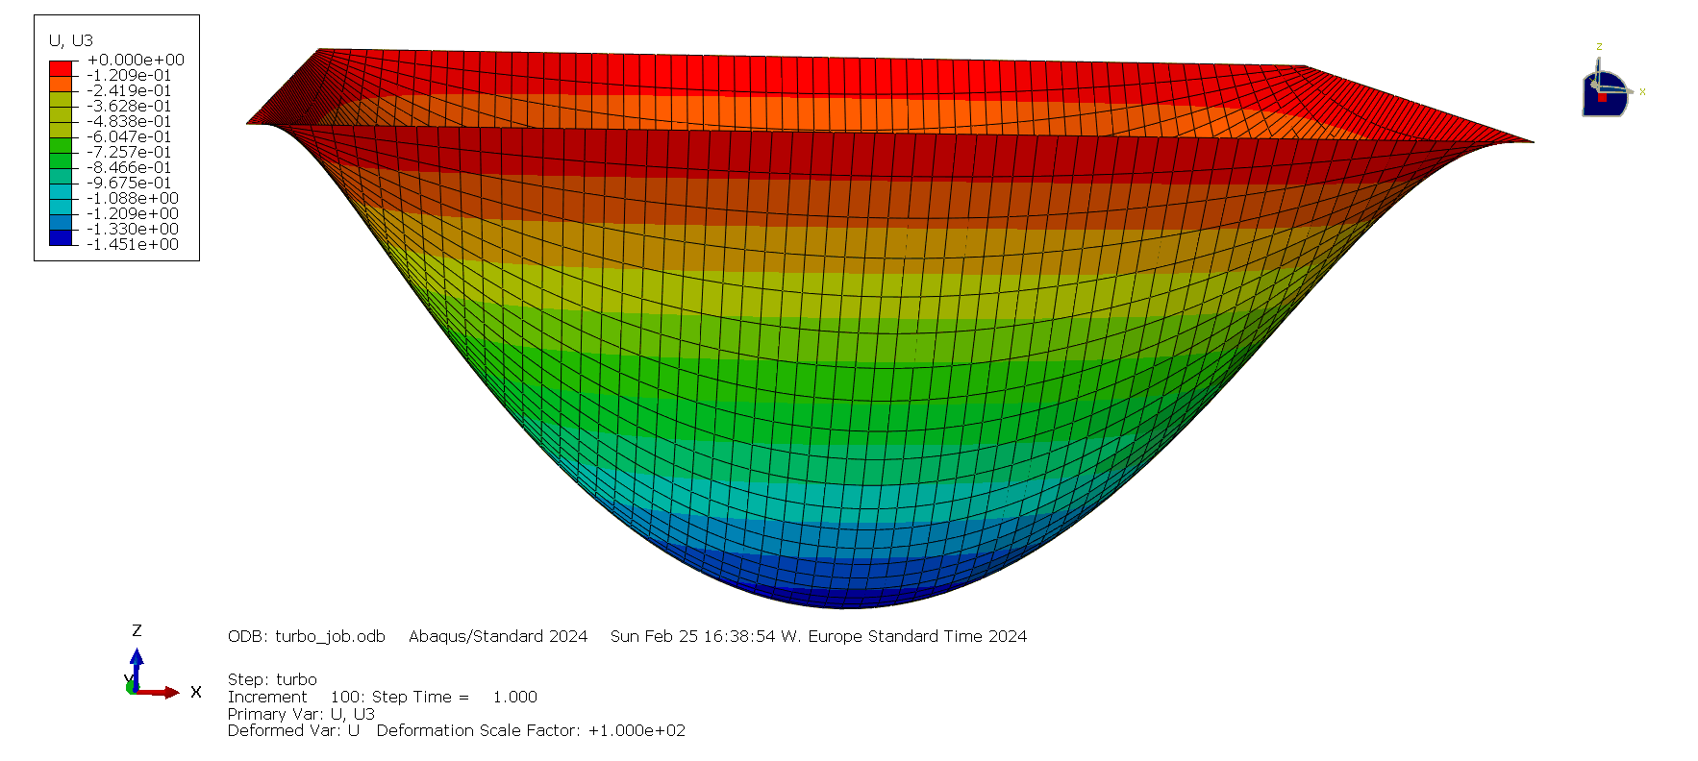
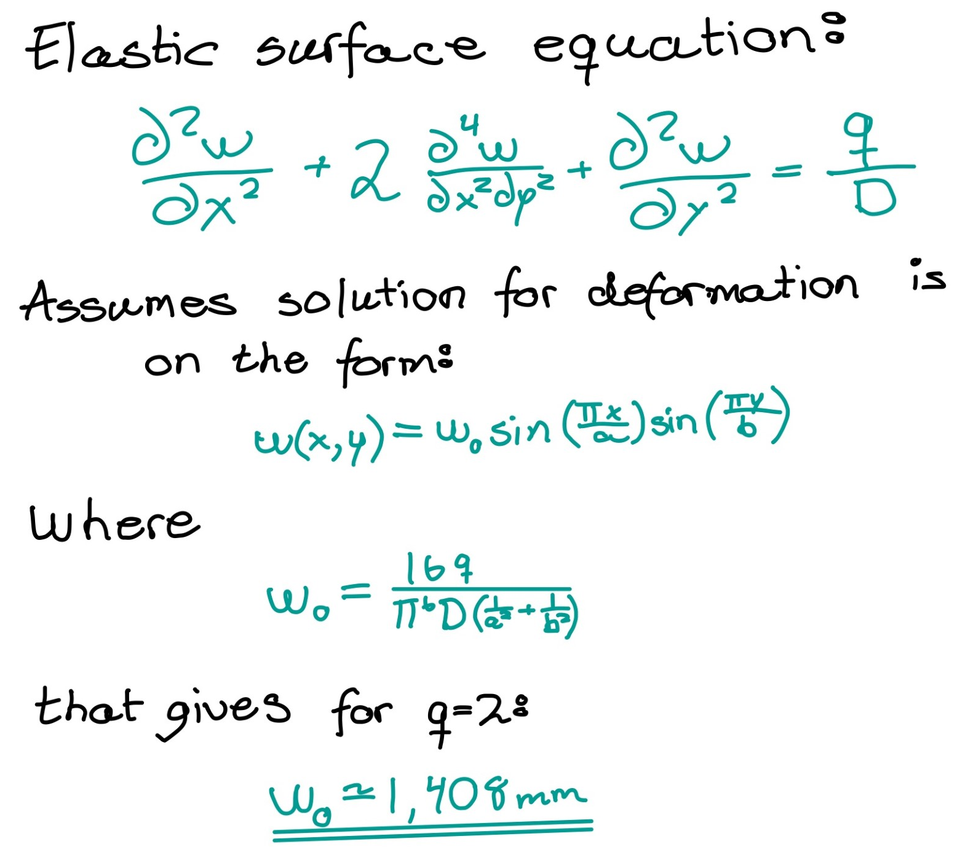
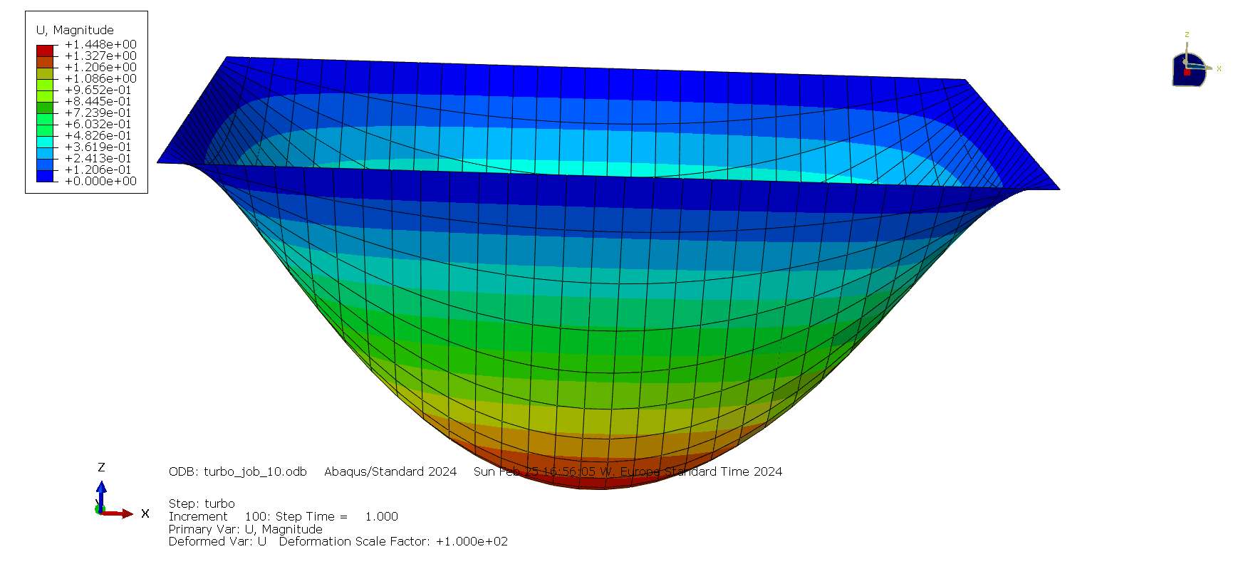
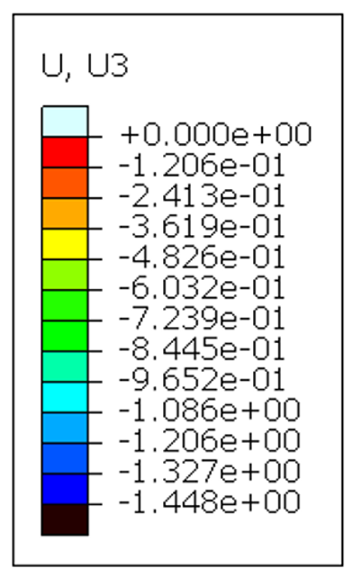
Numerical Solution Comparison
&
Comparison
Numerical solution
5mm mesh
Without feets
*
10mm mesh
Without feets
*https://www.efunda.com/formulae/solid_mechanics/plates/calculators/SSSS_PUniform.cfm#Results

Slide 9

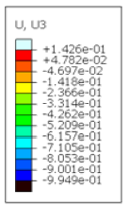
Conclusion
How much force?
=> be careful with the Mac under such forces
Reflection
Hassle to find the formula for the numerical solution
Loads in a node/RP/partision
Could not find a numerical formula for the feet case
Impossible to copy files to/from mac
Could have done
Contact analysis
Rounded corners similar an actual Macbook
Better title
Have a better understanding of mechanics
Edge
~ step 80
= 1.6MPa
feet

Slide 10
Abaqus Model
Step
Static, general
Nlgeom = off
Incrementation: maxInc = 200
Inital = 0.01
Min = 1E-05
Max = 0.01
Part
1. Solid > Extruction:
2. Assign midsurface section
=> shell
Width = 312.6
Height = 221.2
Depth = 15.5
Partition:
feets: r=10mm
Property
Shell, homogenous > shell thickness = 15.5
Isotropic, youngsmodule = 72000
Poissons ratio = 0.333
Mesh
S4R
Load
Pressure:
magnitude: 2
Brown (positive side)
BC:
Feet/edges: U1=U2=U3=0
Assembly
Mesh on part

Slide 11
Sources
https://www.efunda.com/formulae/solid_mechanics/plates/casestudy_list.cfm#SSSS
Powerpoints for this course, as well as the lecture recordings
https://www.youtube.com/watch?v=kb-M0Zt02AI
https://www.youtube.com/watch?v=D-HSGEztygM
SF symbols
Picture: Jony Ive, https://variety.com/2019/digital/news/apple-design-chief-jony-ive-departs-1203255068/
Picture: Macbook Pro https://www.apple.com/newsroom/2021/10/apple-unveils-game-changing-macbook-pro/

